Slide 1

Arabic QA DistilBERT Fine-Tuning
Made by: Mohamed Abdelgaber
Mahmoud Nabil
Ali Helmy
Supervisor: Dr. Mervat Mustafa Fahmy Abuelkheir
Faculty of Media Engineering and Technology (MET)

Slide 2
Contents:
Overview
Dataset
Data Preprocessing & Analysis
Model Architecture
References

Slide 3
1. Overview
Motivation:
Develop a QA model that can accurately and
efficiently answer questions in Arabic language
Growing demand for Arabic NLP applications in various fields
Challenge:
Arabic ⇾ complex language
Not enough data

Slide 4

2. Dataset
17911 QA
SQuAD (Stanford Question Answering Dataset)[2]
Arabic Questions and Answers Dataset (AQAD)[1]
3. Data Preprocessing & Analysis
Dataset
80%
20%
Train
Test

Slide 5
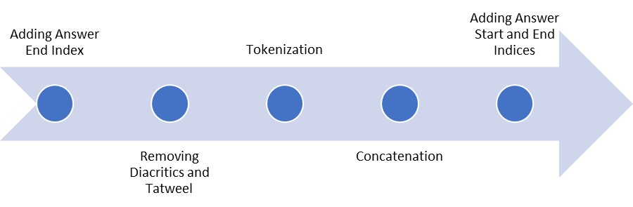
3. Data Preprocessing & Analysis
Data Preprocessing
pipeline:
Fine-tuning

Slide 6
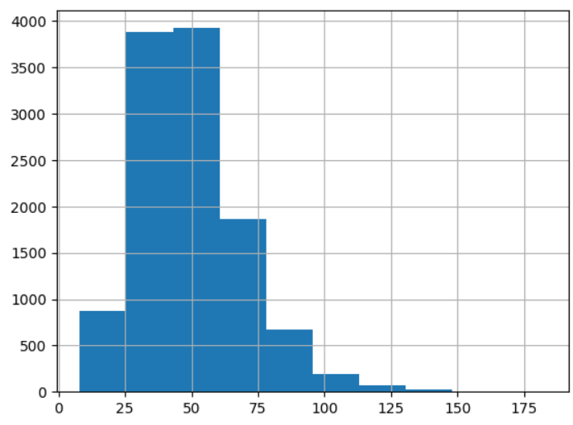
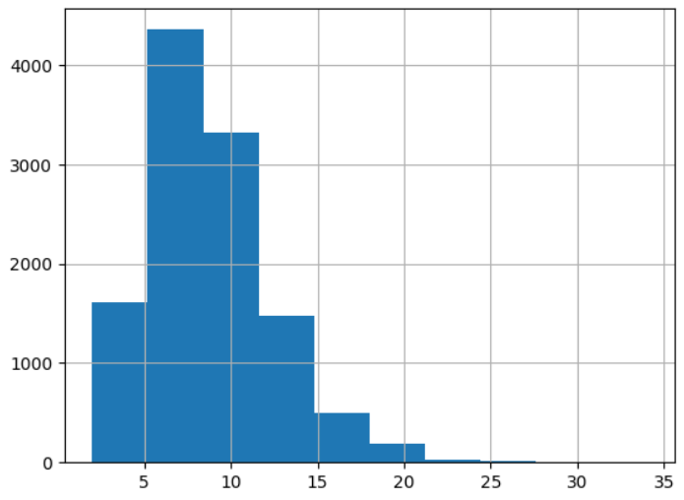
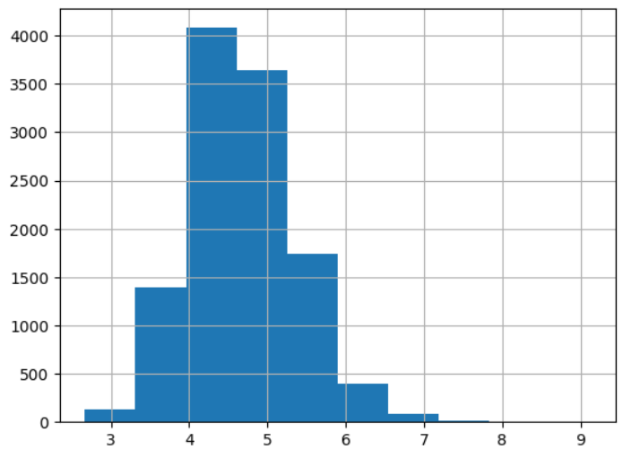
3. Data Preprocessing & Analysis
questions length
number of words per question
word length in each question

Slide 7
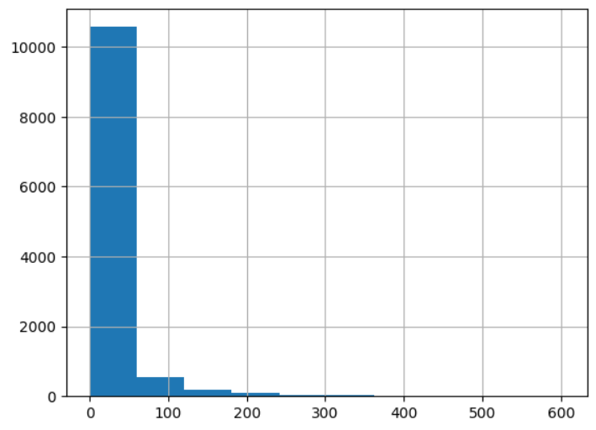
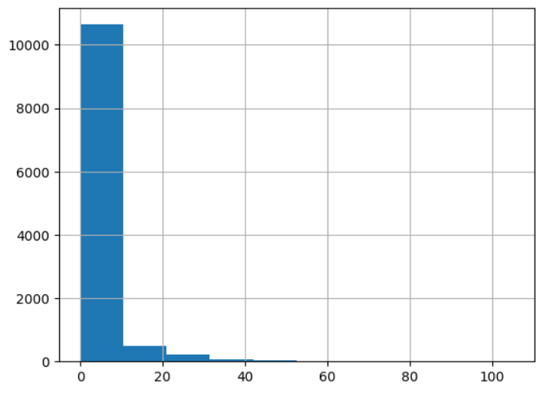
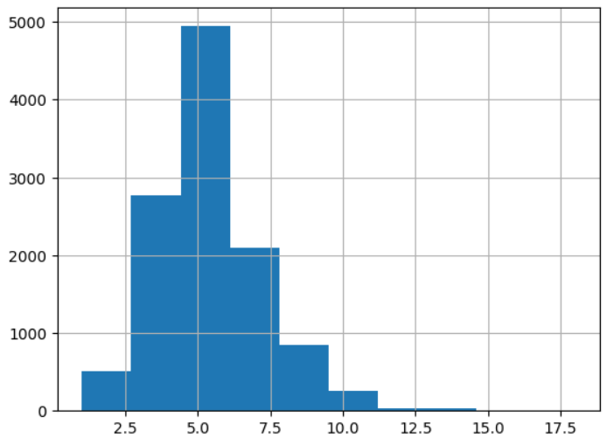
3. Data Preprocessing & Analysis
answers length
number of words per answer
word length in each answer

Slide 8
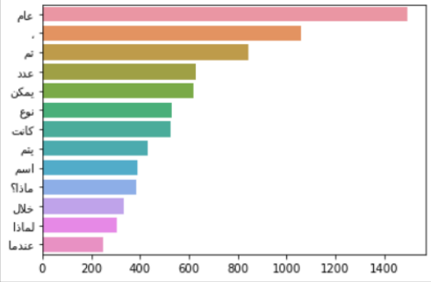
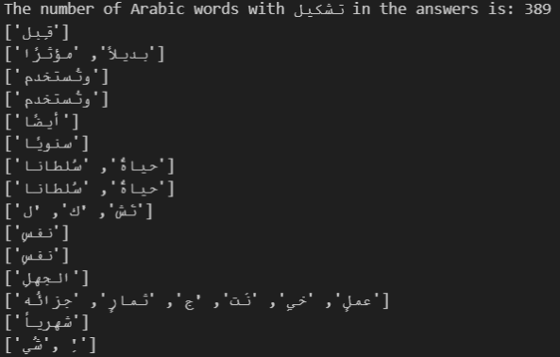
3. Data Preprocessing & Analysis

Slide 9
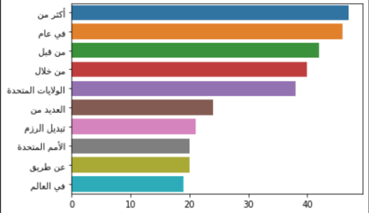
3. Data Preprocessing & Analysis

Slide 10
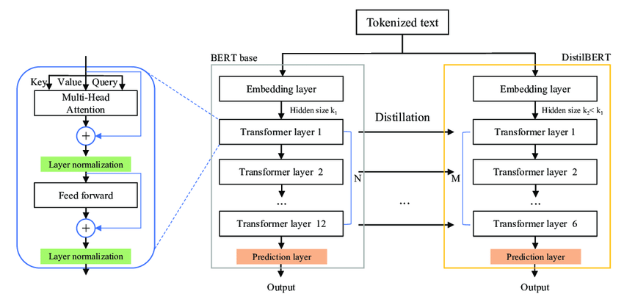
4. Model Architecture

Slide 11
4. Model Architecture
Fine-tuning
Question
+
Context
+
pre processing
+
tokenization
Distilbert model
answer start
+
answer end

Slide 12
6. References
[1] Imane Guellil, Houda Saˆadane, Faical Azouaou, Billel Gueni, and Damien Nouvel. Arabic
natural language processing: An overview. Journal of King Saud University - Computer
and Information Sciences, 33(5):497–507, jun 2021.
[2] Stanford Question Answering Dataset (SQuAD),https://paperswithcode.com/dataset/squad
[3] DistilBERT, a distilled version of BERT: smaller, faster, cheaper and lighter,Victor Sanh and Lysandre Debut and Julien Chaumond and Thomas Wolf,2020,1910.01108

Slide 13
Thank You
Questions?

